Slide 1
10.3: Geometric Sequences and Series
MATH 1550 - Precalculus

Slide 2



Geometric Sequences
Likewise, a geometric sequence ${\left\{a_{n}\right\}}_{n=1}^{N}$ is a sequence where two consecutive terms form a common ratio,
$r=\frac{a_{n+1}}{a_{n}}$.
Ex) Find the common ratio of the geometric sequence
$$1,−3, 9,−27,…$$
Ex) Find the common ratio of the geometric sequence
$$320, 80, 20, 5…$$

Slide 3
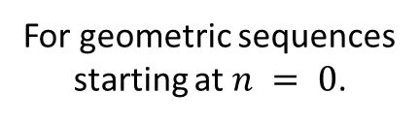

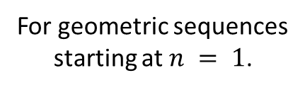



Geometric Sequences
Likewise, a geometric sequence ${\left\{a_{n}\right\}}_{n=1}^{N}$ is a sequence where two consecutive terms form a common ratio,
$r=\frac{a_{n+1}}{a_{n}}$.
$$a_{n}=a_{1}r^{n−1}$$
For geometric sequences
starting at $n = 1$.
$$a_{n}=a_{0}r^{n}$$
For geometric sequences
starting at $n = 0$.
Ex) If ${\left\{a_{n}\right\}}_{n=1}^{N}$ is a geometric sequence with common
ratio $r$, find a formula to generate $a_{n}$ explicitly.
Ex) Find a formula describing the geometric sequence
$$320, 80, 20, 5…$$

Slide 4
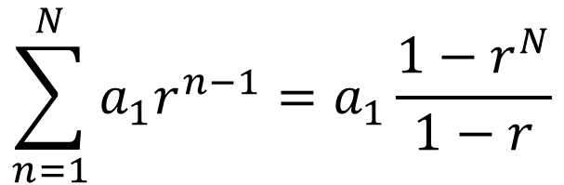


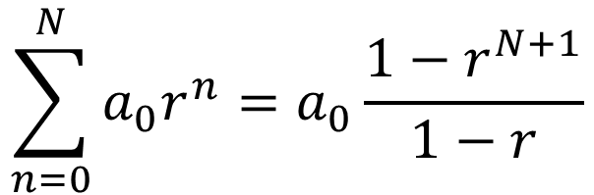
Geometric Series
If ${\left\{a_{n}\right\}}_{n=1}^{N}$ is a (finite) geometric sequence with common ratio $r$, the corresponding geometric series is:
If the geometric sequence starts at 0, then the formula is:
$$\sum_{n=1}^{N}{a_{1}r^{n−1}}=a_{1}\frac{1−r^{N}}{1−r}$$
$$\sum_{n=0}^{N}{a_{0}r^{n}}=a_{0}\frac{1−r^{N+1}}{1−r}$$
Ex) Prove either formula above.
Ex) Compute
$$\sum_{n=1}^{30}{2{\left(\frac{3}{5}\right)}^{n−1}}$$

Slide 5



Geometric Series
If ${\left\{a_{n}\right\}}_{n=1}^{N}$ is a (finite) geometric sequence with common ratio $r≠1$, the corresponding geometric series is:
If the geometric sequence starts at 0, then the formula is:
$$\sum_{n=1}^{N}{a_{1}r^{n−1}}=a_{1}\frac{1−r^{N}}{1−r}$$
$$\sum_{n=0}^{N}{a_{0}r^{n}}=a_{0}\frac{1−r^{N+1}}{1−r}$$
Ex) Compute
$$\sum_{n=1}^{12}{2{\left(\frac{3}{5}\right)}^{n}}$$
Ex) Find the sum of the 1st 9 terms of the geometric series given by $81+9+1+\frac{1}{9}+⋯$

Slide 6


Convergent and Divergent Series
An infinite series $\sum_{n=1}^{∞}{a_{n}}$ is convergent if it has a finite sum. Otherwise, it is divergent.
Ex) Compute
$$\sum_{n=1}^{∞}{\frac{5}{{10}^{n}}}$$

Slide 7


Convergent and Divergent Series
An infinite series $\sum_{n=1}^{∞}{a_{n}}$ is convergent if it has a finite sum. Otherwise, it is divergent.
Ex) Determine the convergence/divergence of
Ex) Determine the convergence/divergence of
$$\sum_{n=1}^{∞}{n}$$
$$\sum_{n=1}^{∞}{{\left(−1\right)}^{n}}$$

Slide 8




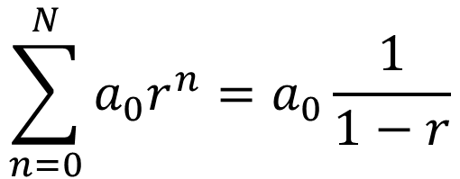
Geometric Series
If ${\left\{a_{n}\right\}}_{n=1}^{∞}$ is an infinite geometric sequence with common ratio $\left|r\right|<1$, the corresponding geometric series is:
If the geometric sequence starts at 0, then the formula is:
$$\sum_{n=1}^{∞}{a_{1}r^{n−1}}=a_{1}\frac{1}{1−r}$$
$$\sum_{n=0}^{N}{a_{0}r^{n}}=a_{0}\frac{1}{1−r}$$
Ex) Find the sum of the geometric series given by
$$81+9+1+\frac{1}{9}+⋯$$
Ex) Find the sum of the geometric series given by
$$\frac{1}{4}−\frac{1}{12}+\frac{1}{36}−\frac{1}{108}+⋯$$

Slide 9

Geometric Series
If ${\left\{a_{n}\right\}}_{n=1}^{∞}$ is an infinite geometric sequence with common ratio $\left|r\right|<1$, the corresponding geometric series is:
If the geometric sequence starts at 0, then the formula is:
$$\sum_{n=1}^{∞}{a_{1}r^{n−1}}=a_{1}\frac{1}{1−r}$$
$$\sum_{n=0}^{N}{a_{0}r^{n}}=a_{0}\frac{1}{1−r}$$
Ex) Express $0.1111…$ as a fraction of integers.
Ex) Find the sum of the geometric series given by
$$\frac{1}{4}−\frac{1}{12}+\frac{1}{36}−\frac{1}{108}+⋯$$

Slide 10
Applications
A rubber ball is dropped from a height of 729 feet, and at each bounce it rebounds half of the height from which it last fell. How far has the ball travelled total by the time it strikes the ground for the 5th time?

